Slide 1

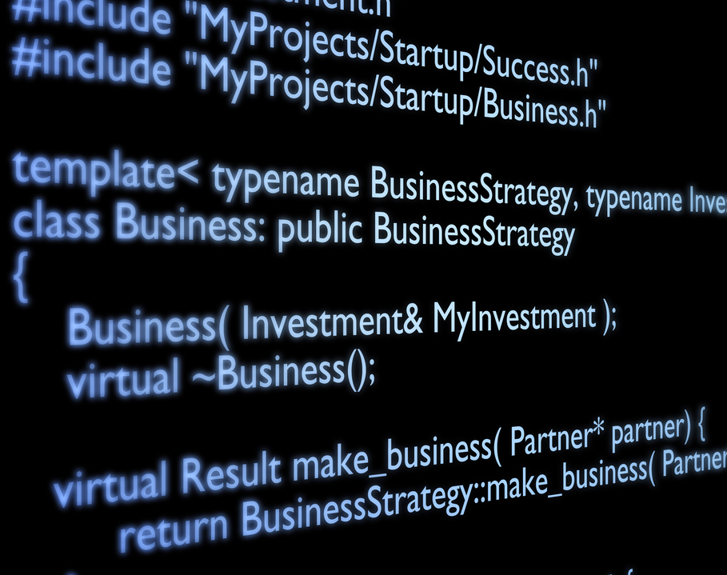

PROGRAMMING FUNDAMENTALS IN C
Introduction to Computers,
the Internet and the Web

Slide 2
Objectives
Write C desktop applications.
Mathematical operations
Loops
If statements
Functions
Arrays
Pointers
Problem solving

Slide 3
Introduction to Computers, the Internet and the Web
Hardware and Software
Data Hierarchy
Machine Languages, Assembly Languages and High-Level Languages
The C Programming Language
C Standard Library
C++ and Other C-Based Languages
Object Technology
Typical C Program-Development Environment
Test-Driving a C Application in Windows
Operating Systems
The Internet and World Wide Web
Some Key Software Terminology
Keeping Up-to-Date with Information Technologies

Slide 4
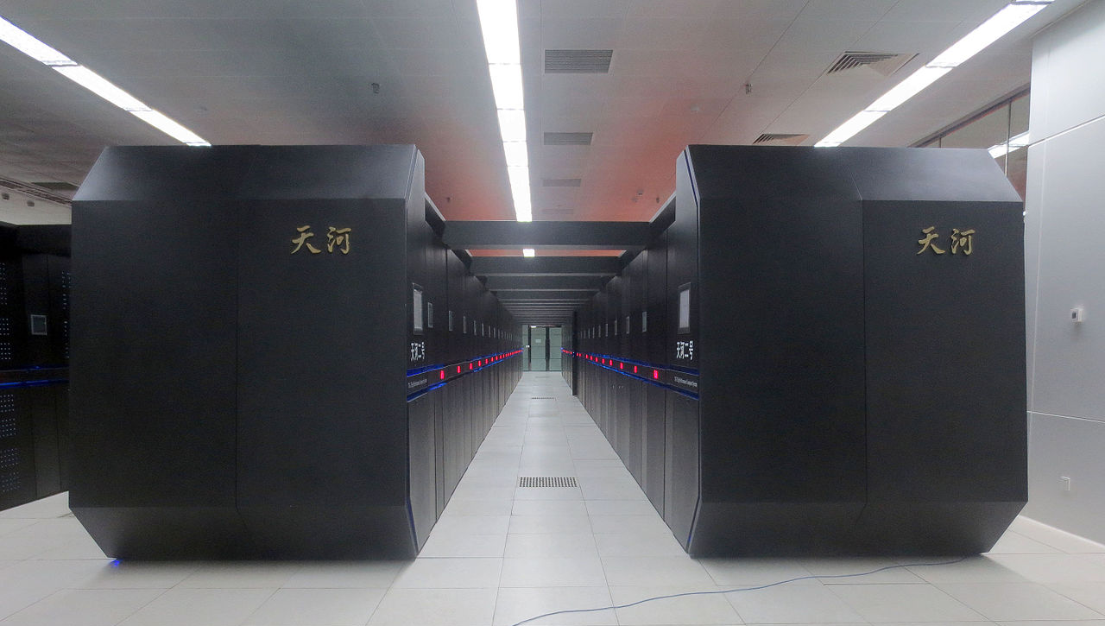
Hardware and Software
Computers can perform calculations and make logical decisions faster than human beings can.
Supercomputers performs thousands of trillions of instructions per second!
The Tianhe-2 supercomputer can perform in one second about 3 million calculations for every person on the planet!

Slide 5
Hardware and Software
Computer System
Hardware
Software

Slide 6
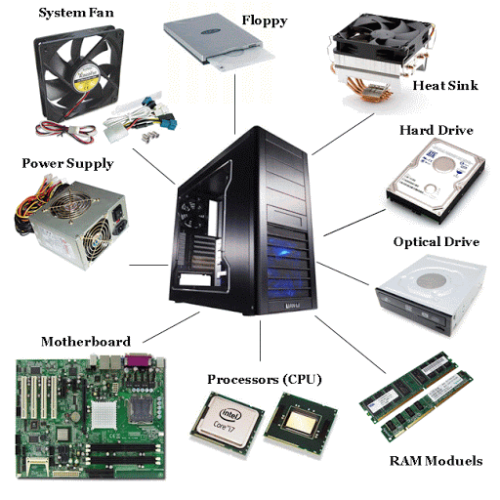
Hardware and Software
Computer System
Hardware
Software
Computer hardware includes the physical parts of a computer.

Slide 7
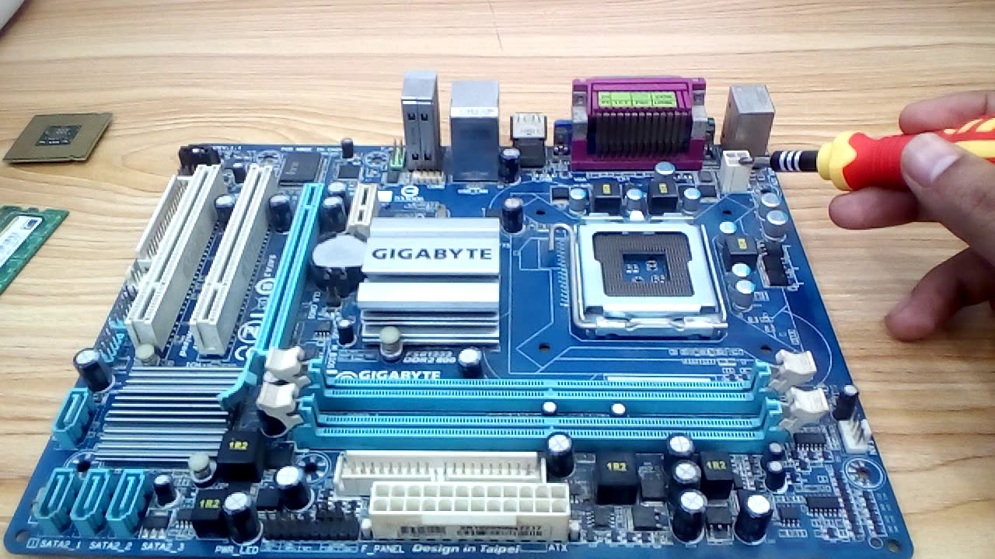
Hardware and Software

Slide 8
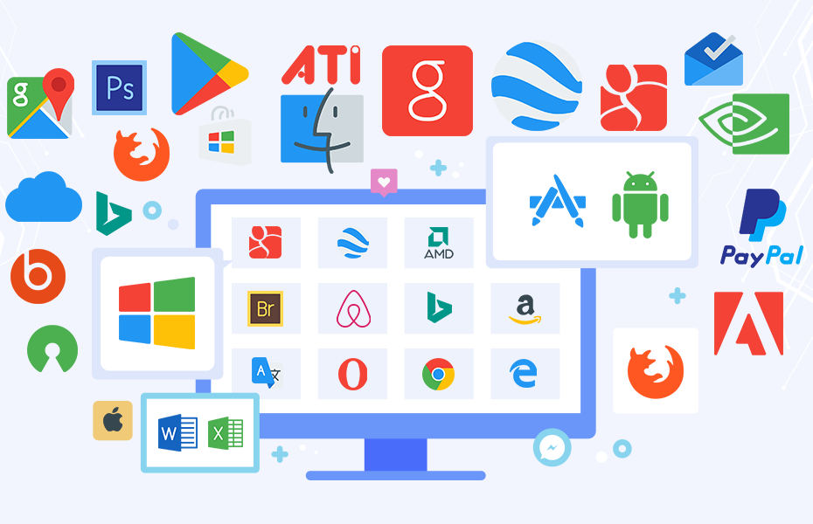
Hardware and Software
Computer System
Hardware
Software
Computer software is a set of instructions tells a computer
what to do or how to perform a task

Slide 9
Introduction to Computers, the Internet and the Web
Hardware and Software
Data Hierarchy
Machine Languages, Assembly Languages and High-Level Languages
The C Programming Language
C Standard Library
C++ and Other C-Based Languages
Object Technology
Typical C Program-Development Environment
Test-Driving a C Application in Windows, Linux and Mac OS X
Operating Systems
The Internet and World Wide Web
Some Key Software Terminology
Keeping Up-to-Date with Information Technologies

Slide 10
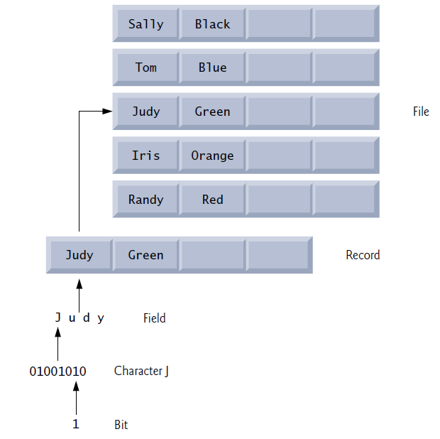
Data Hierarchy
Data items processed by computers form a data hierarchy.
Bits: the smallest data item in a computer can assume the value 0 or the value 1.
Characters: decimal digits (0–9), letters (A–Z and a–z), and special symbols (e.g., $, @, %, &, *, (, ), –, +, ", :, ? and /).
Fields: group of characters or bytes that conveys meaning.
Records: a group of related fields.
Files: a group of related records.

Slide 11
QUIZ
What is a Database?
What Big Data means?
How Images, audios, and videos represented inside a computer?
What are size measurement units of a computer?

Slide 12
Introduction to Computers, the Internet and the Web
Hardware and Software
Data Hierarchy
Machine Languages, Assembly Languages and High-Level Languages
The C Programming Language
C Standard Library
C++ and Other C-Based Languages
Object Technology
Typical C Program-Development Environment
Test-Driving a C Application in Windows, Linux and Mac OS X
Operating Systems
The Internet and World Wide Web
Some Key Software Terminology
Keeping Up-to-Date with Information Technologies

Slide 13
Machine Languages, Assembly Languages and High-Level Languages
Programming Languages
Machine languages
Assembly languages
High-level languages
Programmers write instructions in various programming languages.

Slide 14
Machine Languages, Assembly Languages and High-Level Languages
Programming Languages
Machine languages
Assembly languages
High-level languages
Machine languages consist of strings of numbers (1s and 0s) that instruct computers to perform elementary operations one at a time.
Machine languages are machine dependent.
Example:
+1300042774
+1400593419
+1200274027

Slide 15
Machine Languages, Assembly Languages and High-Level Languages
Programming Languages
Machine languages
Assembly languages
High-level languages
Assembly language is an English-like abbreviations to represent elementary operations.
Translator programs called assemblers convert assembly-language programs to machine language.
Example:
load x
add y
store z

Slide 16
Machine Languages, Assembly Languages and High-Level Languages
Programming Languages
Machine languages
Assembly languages
High-level languages
High-level languages has instructions that look almost like everyday English and contain commonly used mathematical notations.
Translator programs called compilers or interpreters convert high-level language programs into machine language.
Example:
z = x + y

Slide 17



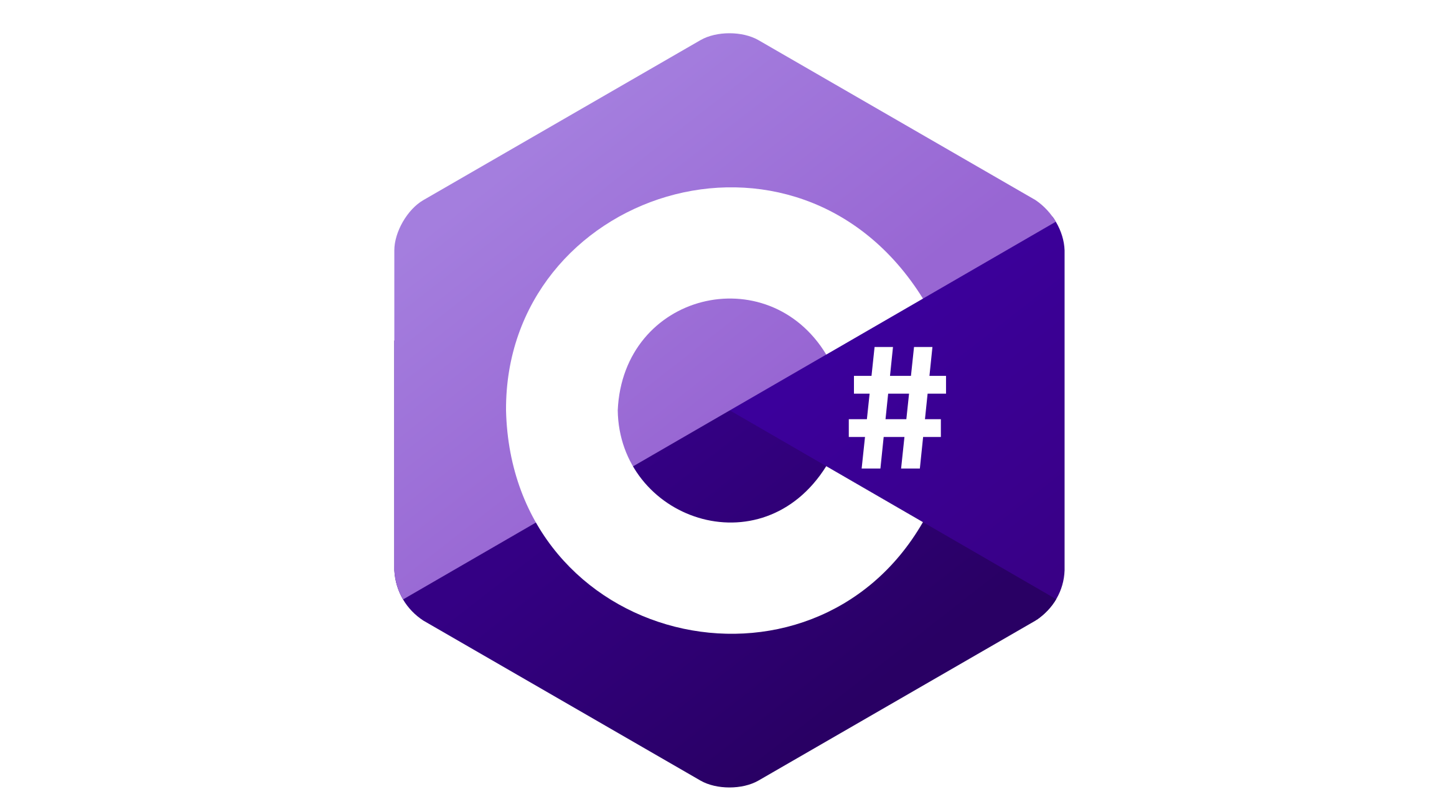
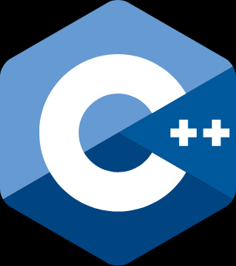
Machine Languages, Assembly Languages and High-Level Languages
High-level programming languages examples:
Java
C#
C++
C
Python

Slide 18
QUIZ
What is the difference between a Compiler and an Interpreter?
Give examples of compiled programming languages
Give examples of interpreted programming languages
Can a language use both schemes (compiled and interpreted)?

Slide 19
Introduction to Computers, the Internet and the Web
Hardware and Software
Data Hierarchy
Machine Languages, Assembly Languages and High-Level Languages
The C Programming Language
C Standard Library
C++ and Other C-Based Languages
Object Technology
Typical C Program-Development Environment
Test-Driving a C Application in Windows, Linux and Mac OS X
Operating Systems
The Internet and World Wide Web
Some Key Software Terminology
Keeping Up-to-Date with Information Technologies

Slide 20


The C Programming Language
C evolved from two previous languages, BCPL and B. BCPL was developed in 1967 by Martin Richards as a language for writing operating systems and compilers.
The C language was evolved from B by Dennis Ritchie at Bell Laboratories and was originally implemented in 1972.

Slide 21
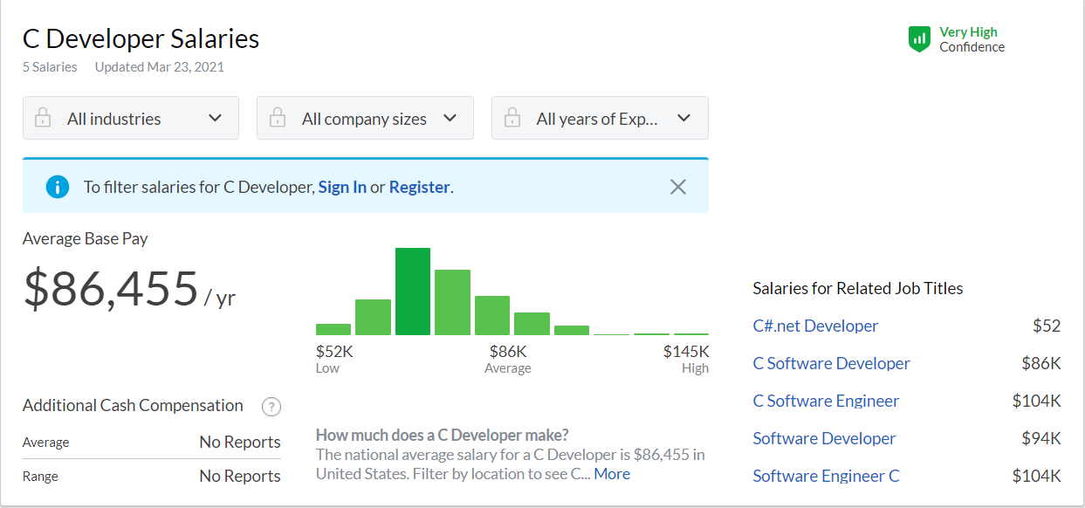
The C Programming Language
C is built for Performance, develop systems that demand performance, such as
Operating systems, embedded systems, real-time systems and communications systems. (See Valeo Jobs)

Slide 22
QUIZ
Is C programming language the BEST choice to develop web applications. State WHY??

Slide 23
Introduction to Computers, the Internet and the Web
Hardware and Software
Data Hierarchy
Machine Languages, Assembly Languages and High-Level Languages
The C Programming Language
C Standard Library
C++ and Other C-Based Languages
Object Technology
Typical C Program-Development Environment
Test-Driving a C Application in Windows, Linux and Mac OS X
Operating Systems
The Internet and World Wide Web
Some Key Software Terminology
Keeping Up-to-Date with Information Technologies

Slide 24
C Standard Library
C programs consist of pieces called functions.
A function is a block of organized, reusable code that is used to perform a single, related action.
C has a collection of existing functions called the C Standard Library.
You can program all the functions that you need to form a C program.
A function to calculate the exponential
A function to set a word to uppercase
A function to read and write to a file

Slide 25
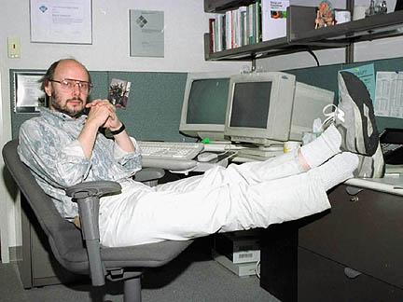
C++ and Other C-Based Languages
C and C++ are companions.
C++ was developed by Bjarne Stroustrup at Bell Laboratories.

Slide 26
C++ and Other C-Based Languages
C++ provides capabilities for object-oriented programming.
Objects are reusable software components that model items in the real world.
Object-oriented design and-implementation approach can make software-development groups more productive.
Almost any noun can be represented as a software object in terms of attributes and behaviours.
Examples: Car, Person, Image, Audio, …
Object-oriented programs are often easier to understand and modify.

Slide 27
Introduction to Computers, the Internet and the Web
Hardware and Software
Data Hierarchy
Machine Languages, Assembly Languages and High-Level Languages
The C Programming Language
C Standard Library
C++ and Other C-Based Languages
Object Technology
Typical C Program-Development Environment
Test-Driving a C Application in Windows, Linux and Mac OS X
Operating Systems
The Internet and World Wide Web
Some Key Software Terminology
Keeping Up-to-Date with Information Technologies

Slide 28
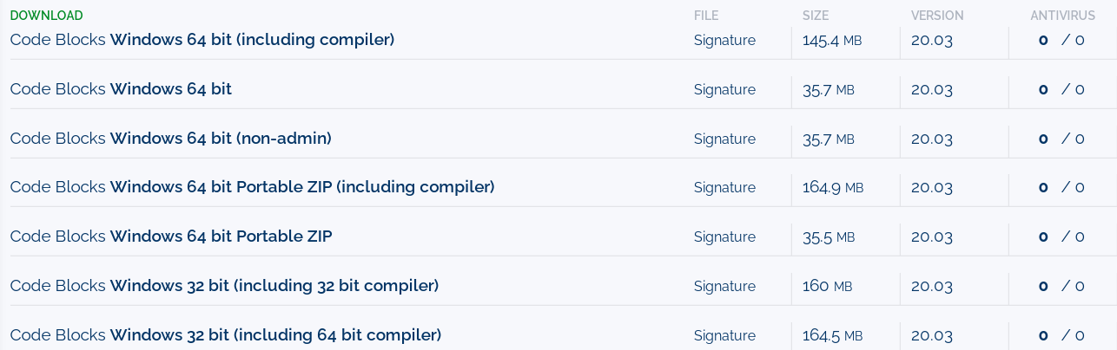
Typical C Program-Development Environment
Download Code Blocks IDE and the compiler
Go to https://www.fosshub.com/Code-Blocks.html?dwl=codeblocks-20.03-setup.exe

Slide 29
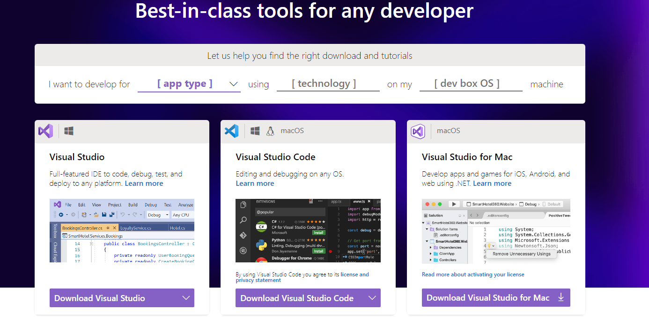
Typical C Program-Development Environment
Download Visual Studio IDE and the compiler
Go to https://visualstudio.microsoft.com/

Slide 30
C Application in Windows
HelloWorld program in C:
Open Visual Studio
Click New Project
Choose Win32 Console application
Set the project’s name and location
Click ok
Select application type as console application
Check empty project
Uncheck SDL checks
Create new source code file in Source Files directory
Write your code
#include<stdio.h>
int main()
{
printf("Hello World\n");
return 0;
}

Slide 31
C Application in Windows
HelloWorld program in C:
Open Visual Studio
Click New Project
Choose Win32 Console application
Set the project’s name and location
Click ok
Select application type as console application
Check empty project
Uncheck SDL checks
Create new source code file in Source Files directory
Write your code
#include<stdio.h>
int main()
{
printf("Hello World\n");
return 0;
}

Slide 32
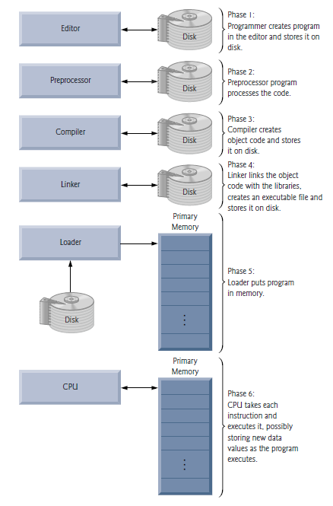
C Application in Windows
C programs go through six phases to be executed

Slide 33
C Application in Windows
C programs get input from stdin (standard input stream)
Keyboard
- mouse clicks, mic
C programs output data to stdout (standard output stream)
Screen
- File, printers

Slide 34
QUIZ
What are the common programming errors?
What is stderr?

Slide 35
Introduction to Computers, the Internet and the Web
Hardware and Software
Data Hierarchy
Machine Languages, Assembly Languages and High-Level Languages
The C Programming Language
C Standard Library
C++ and Other C-Based Languages
Object Technology
Typical C Program-Development Environment
Test-Driving a C Application in Windows, Linux and Mac OS X
Operating Systems
The Internet and World Wide Web
Some Key Software Terminology
Keeping Up-to-Date with Information Technologies

Slide 36
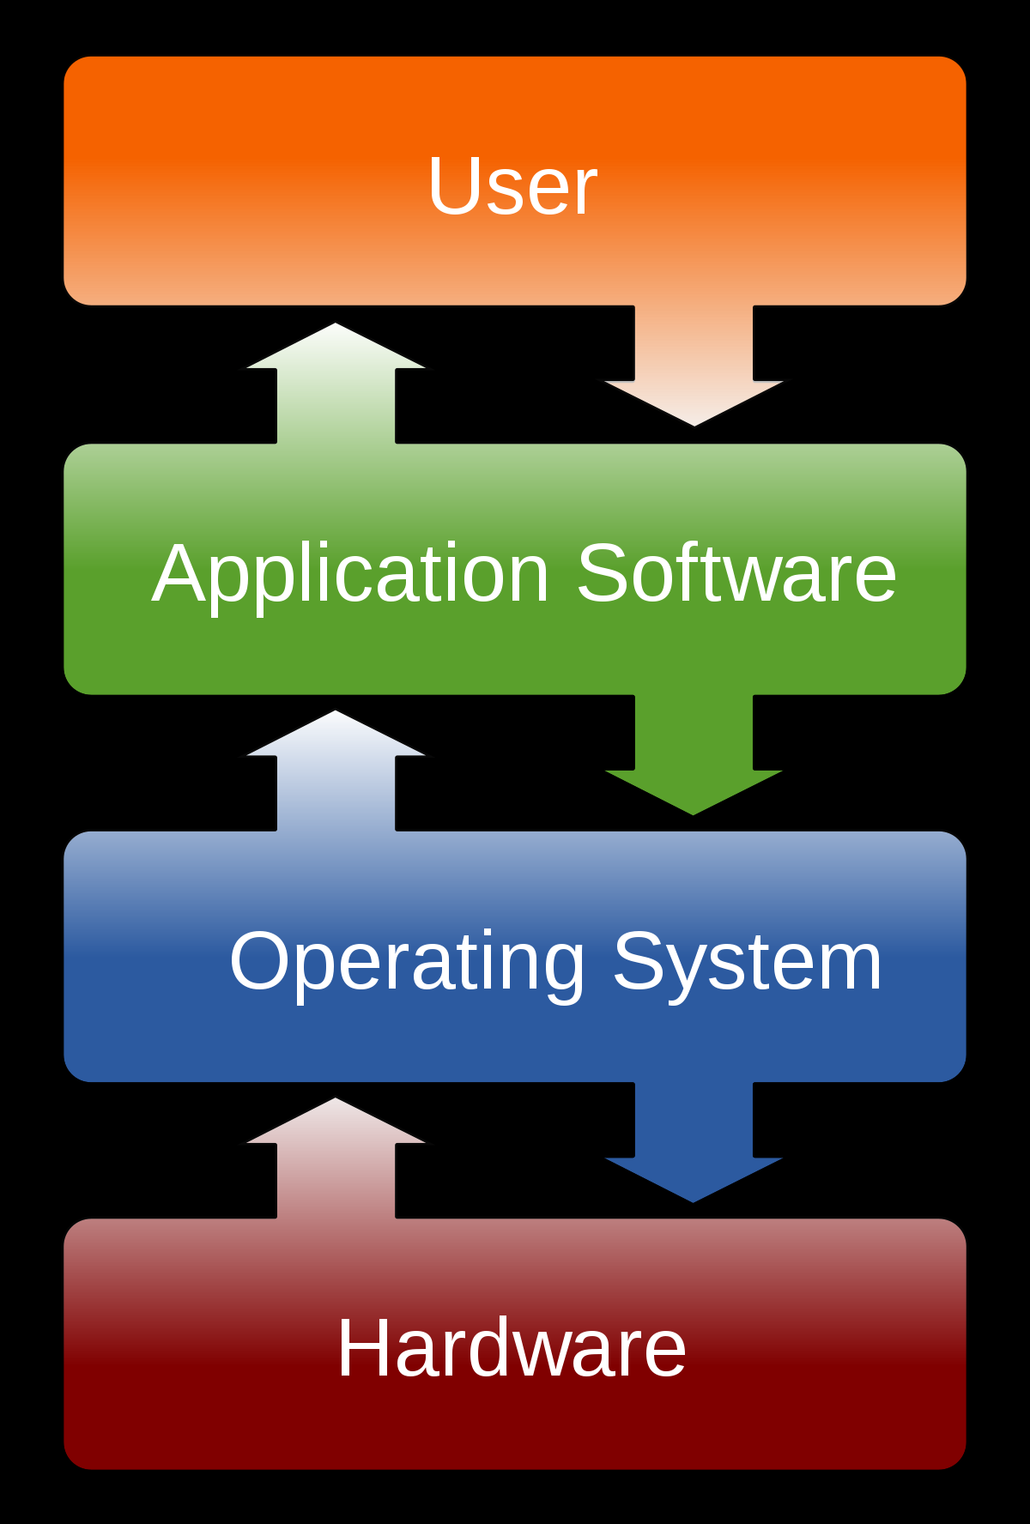
Operating Systems
An Operating System (OS) is an interface between a computer user and computer hardware.
Allow each application to execute safely, efficiently and concurrently with other applications.
File management
Memory management
Process management
Handling input and output
Controlling peripheral devices

Slide 37
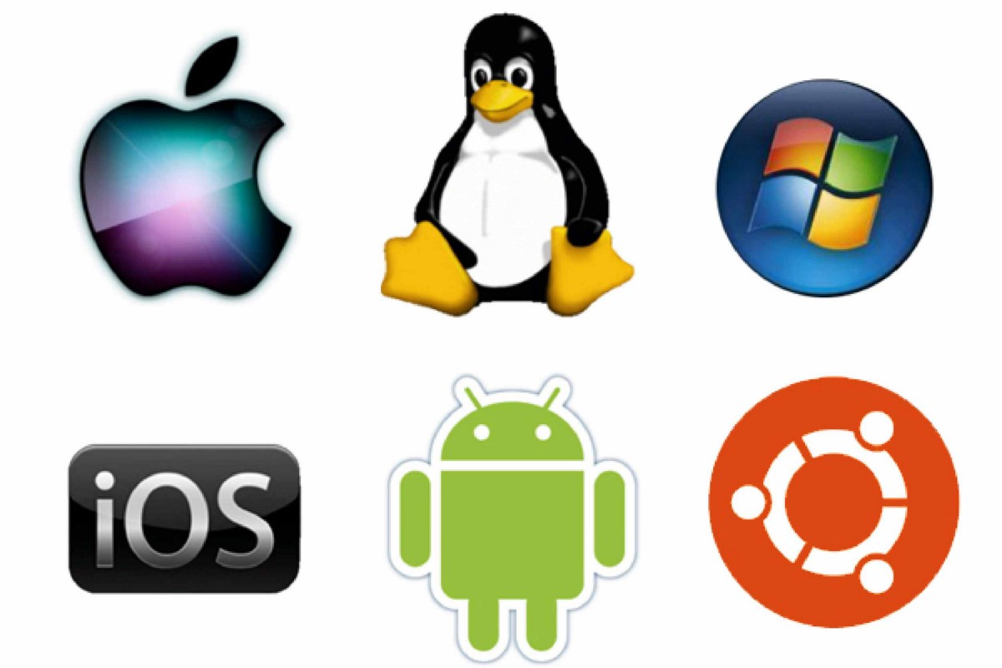
Operating Systems
Operating systems examples:
Windows: XP, VISTA, 7, 8, 10, Windows Server
Linux: Ubuntu, Debian, Fedora, CentOS
Mac: Mac OS X
Android: Jelly Beans ,Nugat, Oreo
IOS: IOS 11

Slide 38
QUIZ
What is an OS kernel?
How do computers boot up?

Slide 39
Introduction to Computers, the Internet and the Web
Hardware and Software
Data Hierarchy
Machine Languages, Assembly Languages and High-Level Languages
The C Programming Language
C Standard Library
C++ and Other C-Based Languages
Object Technology
Typical C Program-Development Environment
Test-Driving a C Application in Windows, Linux and Mac OS X
Operating Systems
The Internet and World Wide Web
Some Key Software Terminology
Keeping Up-to-Date with Information Technologies

Slide 40
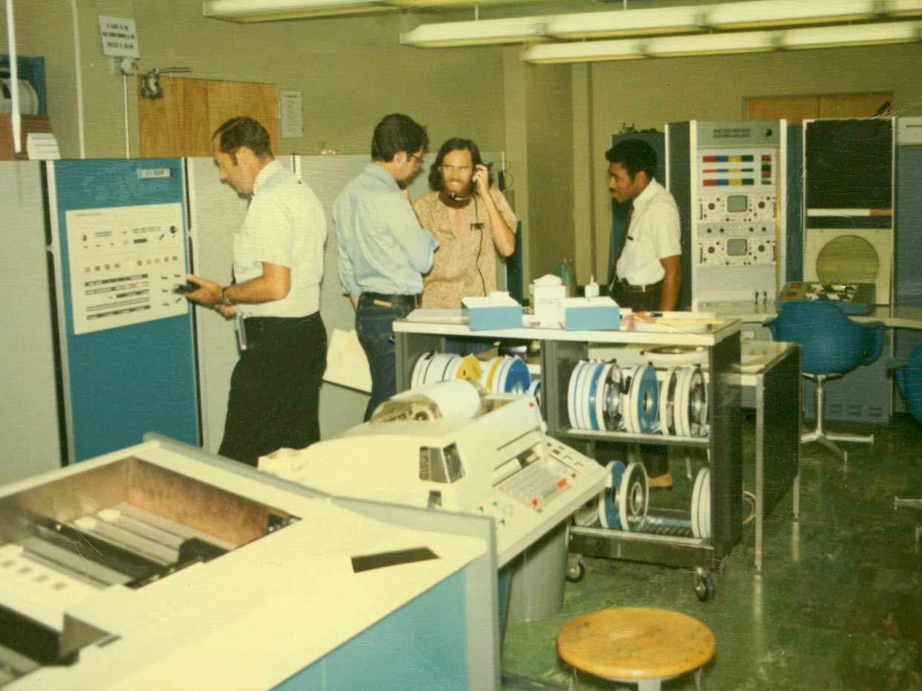
The Internet and World Wide Web
The Internet is a global network connects computer systems across the world.
ARPANET was the network that became the basis for the Internet.

Slide 41
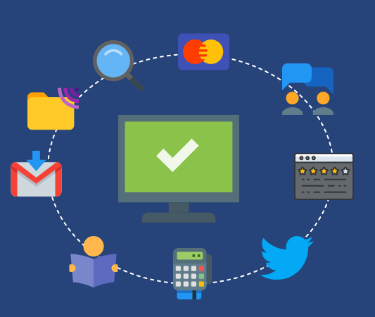
The Internet and World Wide Web
ARPANET developed over years to become today’s Internet.
Social media
Instant messaging
Emailing
Marketing
Multimedia
File transfer
The internet is a network of networks.

Slide 42
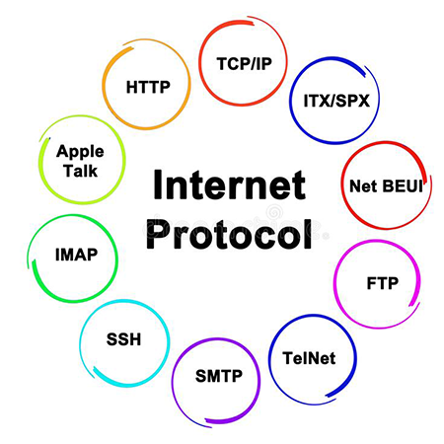
The Internet and World Wide Web
Internet uses a set of protocols for communications
IP, TCP, UDP, HTTPS
A protocol is a set of rules that control the communication process between devices.

Slide 43
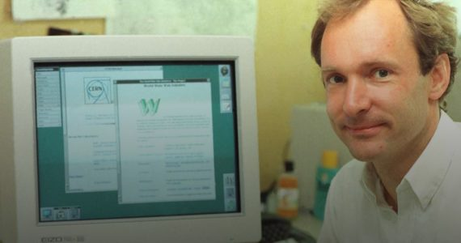
The Internet and World Wide Web
The World Wide Web is a collection of hardware and software associated with the Internet allows computer users to locate and view multimedia-based documents.
Sharing documents via HTML documents and HTTP protocol
Founded in in 1989 by Tim Berners-Lee.

Slide 44
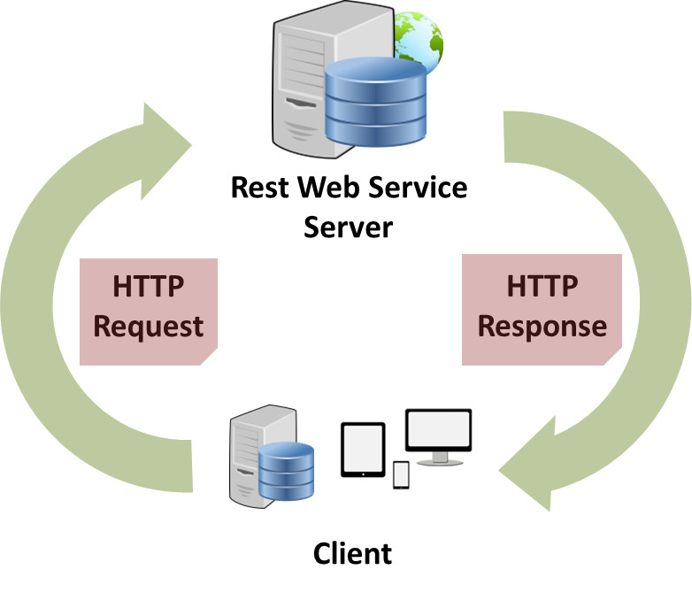

The Internet and World Wide Web
Web services are software components stored on one computer that can be accessed by another computer over the Internet.
Google Maps, Facebook, Instagram, PayPal

Slide 45
The Internet and World Wide Web
Ajax technology helps Internet-based applications perform like desktop applications.
Provides reliable, fast, and dynamic performance.
AJAX allows web pages to be updated asynchronously by exchanging small amounts of data with the server behind the scenes.
Update parts of a web page, without reloading the whole page.
Google Maps uses AJAX.

Slide 46
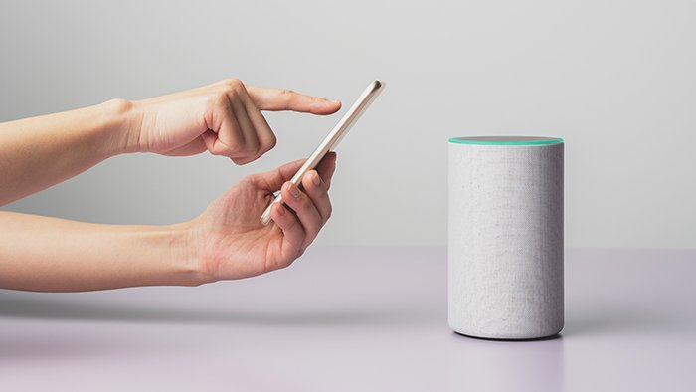
The Internet and World Wide Web
Internet of Things describes the network of physical objects.
Wash machines, smart TVs, cars, home assistants.

Slide 47
Introduction to Computers, the Internet and the Web
Hardware and Software
Data Hierarchy
Machine Languages, Assembly Languages and High-Level Languages
The C Programming Language
C Standard Library
C++ and Other C-Based Languages
Object Technology
Typical C Program-Development Environment
Test-Driving a C Application in Windows, Linux and Mac OS X
Operating Systems
The Internet and World Wide Web
Some Key Software Terminology
Keeping Up-to-Date with Information Technologies

Slide 48
Some Key Software Terminology
Agile software development is a set of methodologies that try to get software implemented faster and using fewer resources.
Refactoring involves reworking programs to make them clearer and easier to maintain while preserving their correctness and functionality.
Widely employed with agile development methodologies
Design patterns are architectures for constructing flexible and maintainable object-oriented software.
Develop better-quality software using less time, money and effort.

Slide 49
Some Key Software Terminology
LAMP and WAMP are technologies for building web applications
LAMP = Linux, Apache, MySQL and PHP (or Perl, Python)
WAMP = Windows, Apache, MySQL and PHP.
Software Development Kit (SDK) are tools and documentation for developers to program applications.
Android SDK
Cloud computing is the availability of computer system resources, especially data storage and computing power over the Internet.

Slide 50
Some Key Software Terminology
Software development is a complex process and may take months or even years to design and implement.
Large software products are made available to the user communities as a series of releases.
Alpha software, is the earliest release of a software product that’s still under active development.
Beta versions, are released to a larger number of developers later in the development process after fixing bugs.
Release candidates, are nearly complete and ready for use by the community.
Final release, fixing bugs in release candidate and the final product is released to the general public.
Continuous beta, hosted in the cloud and is constantly evolving so that users always have the latest version.

Slide 51
Introduction to Computers, the Internet and the Web
Hardware and Software
Data Hierarchy
Machine Languages, Assembly Languages and High-Level Languages
The C Programming Language
C Standard Library
C++ and Other C-Based Languages
Object Technology
Typical C Program-Development Environment
Test-Driving a C Application in Windows, Linux and Mac OS X
Operating Systems
The Internet and World Wide Web
Some Key Software Terminology
Keeping Up-to-Date with Information Technologies

Slide 52
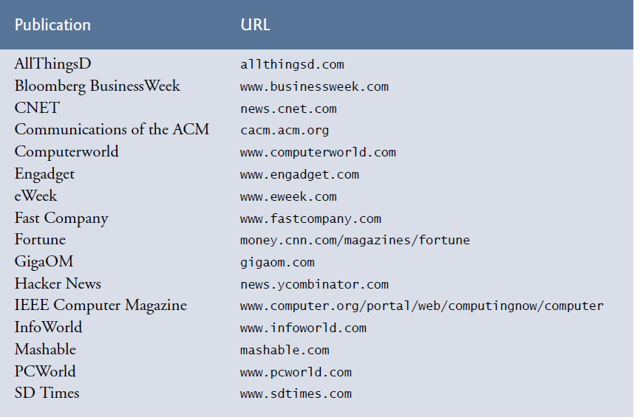
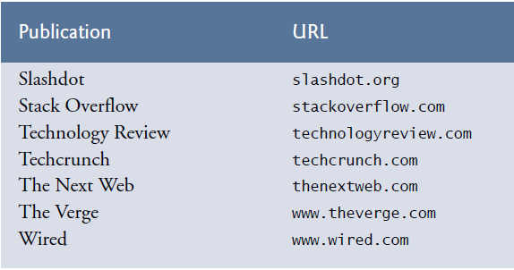
Keeping Up-to-Date with Information Technologies

Slide 53
Summary
Basic computer concepts.
The different types of programming languages.
The history of the C programming language.
The purpose of the C Standard Library.
The basics of object technology.
A typical C program development environment.
To test-drive a C application in Windows
Some basics of the Internet and the World Wide Web.

